Slide 1
BASIC ELECTRONICS
(24B11EC111)
Unit-1
Lecture-2
(Kirchhoff’s Laws)

Slide 2
CONTENTS
Introduction
Kirchhoff’s Laws
Kirchhoff’s Current Law (KCL)
Kirchhoff’s Voltage Law (KVL)
Problems and solutions
Practice Problems
References

Slide 3
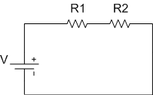
Circuit
An electrical circuit is a closed path consisting of active and passive elements, all interconnected, and the current flow is confined to the closed path.
An active element supplies energy to the circuit, whereas a passive element receives energy.
This energy is converted into heat (resistor) or stored in an electric (capacitor) or magnetic field (inductor).

Slide 4
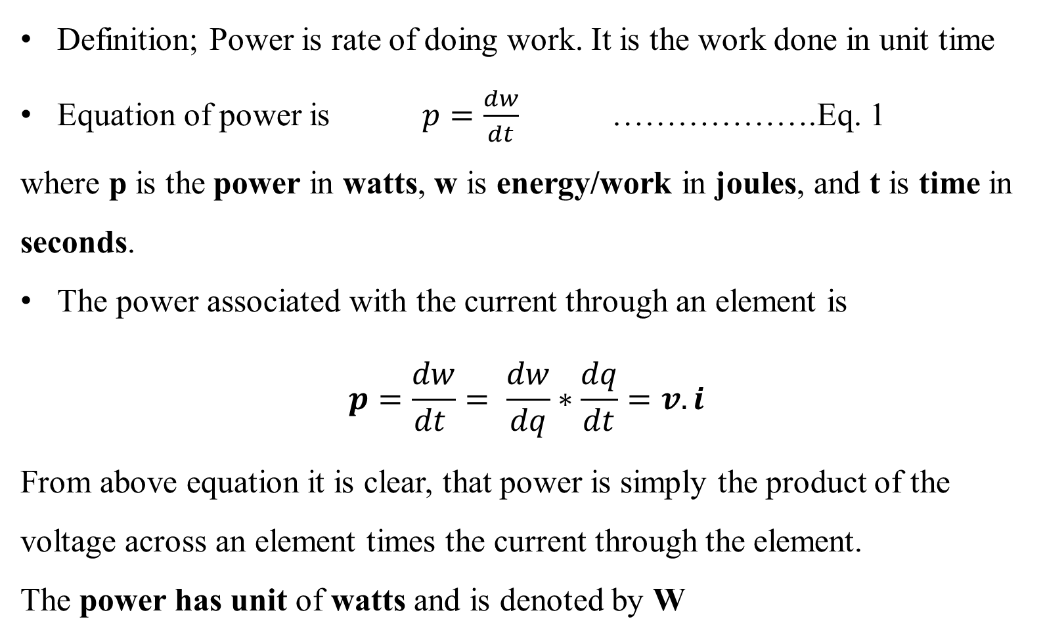
Power
Definition; Power is rate of doing work. It is the work done in unit time
Equation of power is $p=\frac{dw}{dt}$ ……………….Eq. 1
where p is the power in watts, w is energy/work in joules, and t is time in seconds.
The power associated with the current through an element is
$$p=\frac{dw}{dt }= \frac{dw}{dq}∗\frac{dq}{dt}=v.i$$
From above equation it is clear, that power is simply the product of the voltage across an element times the current through the element.
The power has unit of watts and is denoted by W

Slide 5
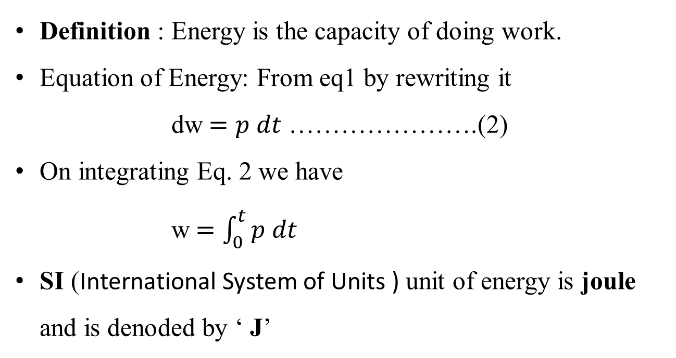
Energy
Definition : Energy is the capacity of doing work.
Equation of Energy: From eq1 by rewriting it
dw$=p dt$ ………………….(2)
On integrating Eq. 2 we have
w$=\int_{0}^{t}{p dt}$
SI (International System of Units ) unit of energy is joule and is denoded by ‘ J’

Slide 6
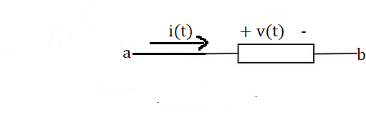
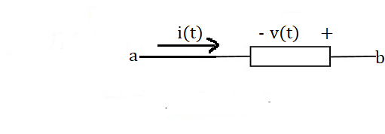
Power Received and Supplied by an element
Figure 1 illustrates two distinct ways to arrange the direction of the current and the polarity of the voltage.
In Figure 1(a), the current is directed from the + toward the – of the voltage polarity. In this, the voltage and current are said to “adhere to the passive convention.”
The passive sign convention is a rule used to determine the sign of power in a circuit.
The power calculated is known as the power received.
(a)
(b)
Figure 1 (a)The element voltage and current adhere to the passive convention. (b) The element voltage and current do not adhere to the passive convention.

Slide 7
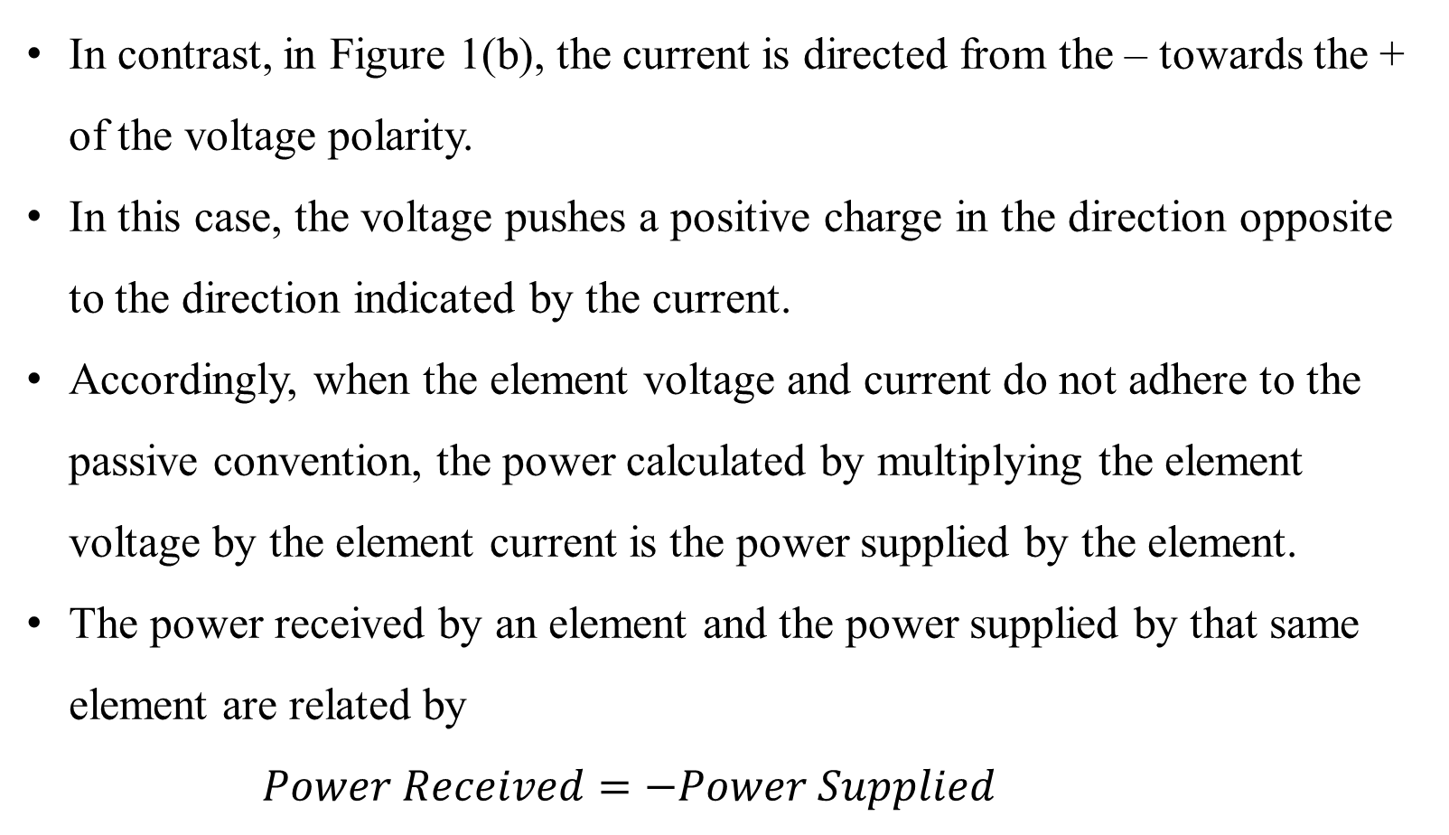
Contd..
In contrast, in Figure 1(b), the current is directed from the – towards the + of the voltage polarity.
In this case, the voltage pushes a positive charge in the direction opposite to the direction indicated by the current.
Accordingly, when the element voltage and current do not adhere to the passive convention, the power calculated by multiplying the element voltage by the element current is the power supplied by the element.
The power received by an element and the power supplied by that same element are related by
$$Power Received=−Power Supplied$$

Slide 8
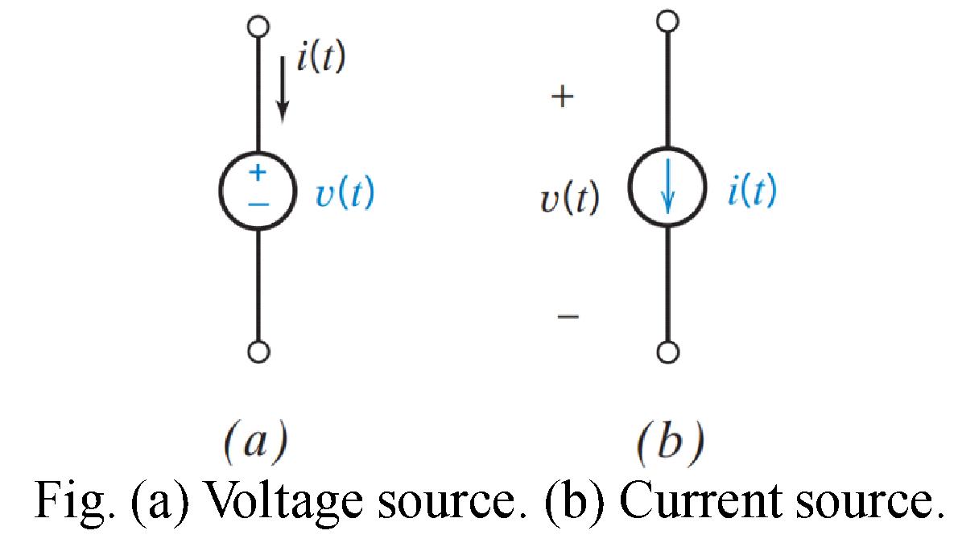
SOURCES
Sources – Are the devices that are intended to supply energy to a circuit.
A source is a voltage or current generator capable of supplying energy to a circuit.
An active two-terminal element that supplies energy to a circuit is a source of energy.
Sources are categorized as : voltage sources and current sources.

Slide 9
INDEPENDENT SOURCES
Independent source: a voltage or current generator not dependent on other circuit variables.
Independent voltage source: provides a specified voltage independent of the current through it and is independent of any other circuit variable.
For example, a voltage source specified by v(t) = 9 volts will have a voltage of 9 volts regardless of the circuit in which it is used. In contrast, the current of the voltage source depends on the circuit in which the source is used.
Independent current source: provides a current, independent of the voltage across the source element and is independent of any other circuit variable.
For example, a current source specified by i(t) = —0.25 milliamps will have a current of —0.25 milliamps in any circuit in which it is used. The voltage across this current source will depend on the particular circuit.

Slide 10
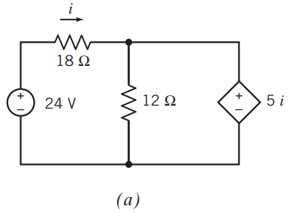
DEPENDENT SOURCES
Dependent sources model the situation in which the voltage or current of one circuit element is proportional to the voltage or current of the second circuit element.
(In contrast, a resistor is a circuit element in which the voltage of the element is proportional to the current in the same element.)
Dependent sources are used to model electronic devices such as transistors and amplifiers. For example, the output voltage of an amplifier is proportional to the input voltage of that amplifier, so an amplifier can be modeled as a dependent source.
Fig. (a) shows a circuit that includes a dependent source represented by the diamond symbol. The plus/minus signs identify the dependent source as a voltage source and indicate the reference polarity of the element voltage.

Slide 11
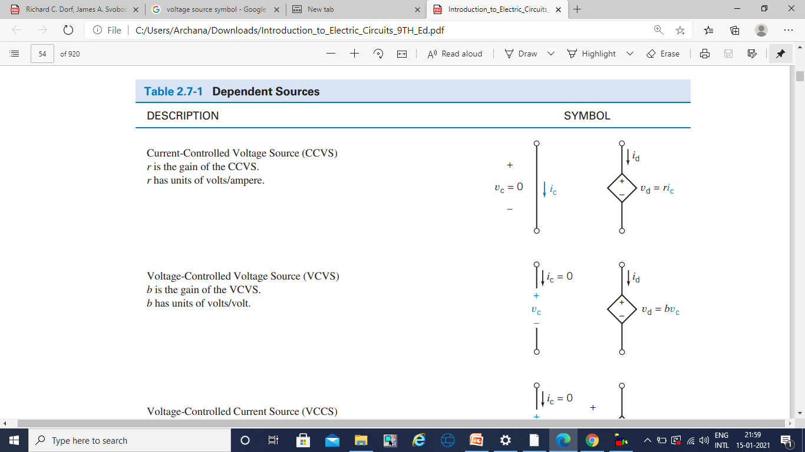
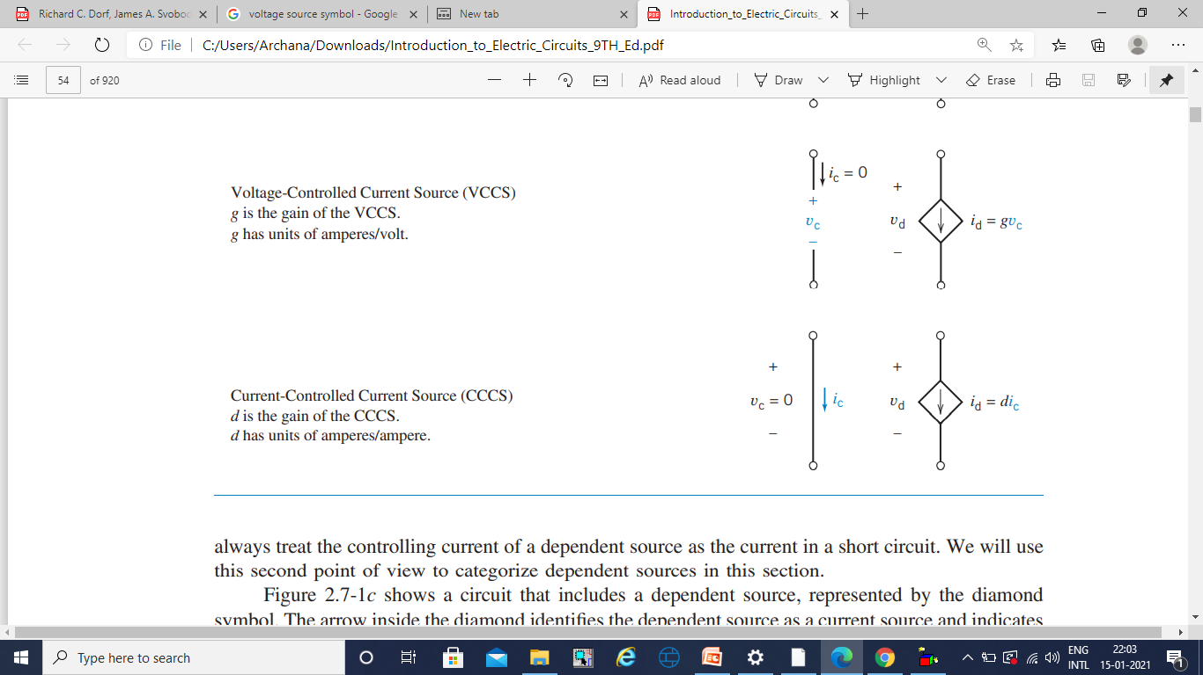
TYPES OF DEPENDENT SOURCES: SYMBOLS
Current-Controlled Voltage Source (CCVS)
r is the gain of the CCVS.
r has units of volts/ampere.
Voltage-Controlled Voltage Source (VCVS)
b is the gain of the VCVS.
b has units of volts/volt.
Voltage-Controlled Current Source (VCCS)
g is the gain of the VCCS.
g has units of amperes/volt.
Current-Controlled Current Source (CCCS)
d is the gain of the CCCS.
d has units of amperes/ampere.

Slide 12
Kirchhoff’s Laws
In 1847, Gustav Robert Kirchhoff, a professor at the University of Berlin, formulated two important laws that provide the foundation for the analysis of electric circuits.
These laws are referred to as Kirchhoff’s current law (KCL) and Kirchhoff’s voltage law (KVL).
Kirchhoff’s laws are a consequence of the conservation of charge and the conservation of energy.
Kirchhoff’s current law (KCL): The algebraic sum of the currents into a node at any instant is zero.

Slide 13
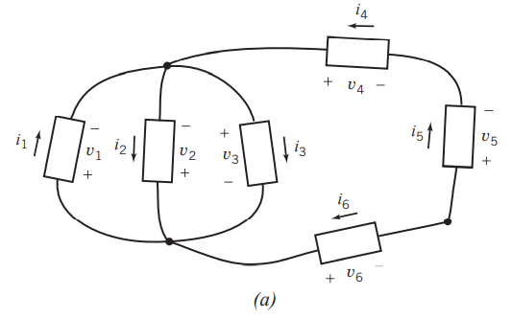
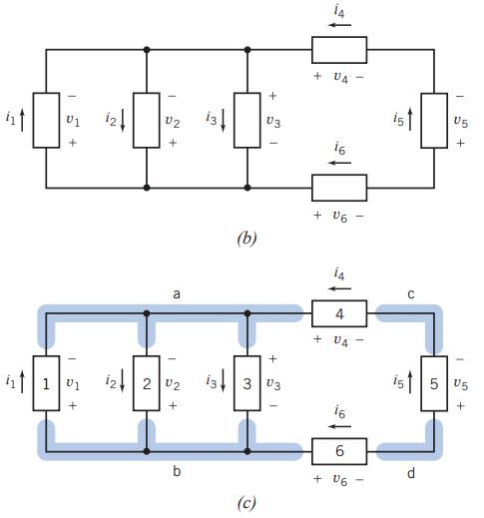
Kirchhoff’s Laws…
Figure (a) shows an electric circuit that consists of six elements connected at four nodes.
It is common practice to draw electric circuits using straight lines and to position the elements horizontally or vertically as shown in Figure (b).
FIGURE (a) An electric circuit. (b) The same circuit, redrawn using straight lines and horizontal and vertical elements.

Slide 14
Kirchhoff’s Current Law (KCL)
Consider the same circuit after labeling the nodes and elements.
Four elements of this circuit 1, 2, 3, and 4 are connected to node a.
By Kirchhoff’s current law, the algebraic sum of the element currents i₁, i₂, i₃, and i₄ must be zero.
Currents i₂ and i₃ are directed away from node a, so we will use a plus sign for i₂ and i₃. In contrast, currents i₁ and i₄ are directed toward node a, so we will use a minus sign for i₁ and i₄.
The KCL equation for node a
-i₁+i₂+i₃-i₄ = 0
The circuit after labeling the nodes and elements.

Slide 15
Kirchhoff’s Current Law (KCL)
An alternate way is to set the sum of all the currents directed away from the node equal to the sum of all the currents directed toward that node.
i₂+i₃= i₁+i₄
Similarly, the Kirchhoff’s current law equation for node b
i₁ = i₂+i₃+i₆

Slide 16
Kirchhoff’s Voltage Law (KVL)
Kirchhoff’s voltage law (KVL): The algebraic sum of the voltages around any loop in a circuit is identically zero for all time.
The phrase algebraic sum indicates that we must take polarity into account as we add up the voltages of elements that comprise a loop.
One way to take polarity into account is to move around the loop in the clockwise direction while observing the polarities of the element voltages.
For example, consider the circuit shown in Figure c. Elements 3, 4, 5, and 6 comprise a loop of the circuit.
By Kirchhoff’s voltage law, the algebraic sum of the element voltages v₃, v₄, v₅, and v₆ must be zero.
v₄ - v₅ - v₆ - v₃ = 0
Similarly, the KVL equation for
the loop consisting of (1, 4, 5, 6) is
v₄ - v₅ - v₆ + v₁ = 0
the loop consisting of (1 and 2) is
- v₂ + v₁ = 0

Slide 17
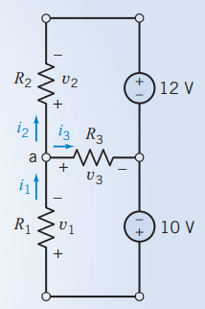
Problems
Problem 1. Consider the circuit shown in Figure. Notice that the passive convention was used to assign reference directions to the resistor voltages and currents. This anticipates using Ohm’s law. Find each current and each voltage when R₁ = 8 Ω, v₂ = -10 V, i₃ = 2 A, and R₃ = 1 Ω. Also, determine the resistance R₂.

Slide 18
Problems
Problem 1. Consider the circuit shown in Figure. Notice that the passive convention was used to assign reference directions to the resistor voltages and currents. This anticipates using Ohm’s law. Find each current and each voltage when R₁ = 8 Ω, v₂ = -10 V, i₃ = 2 A, and R₃ = 1 Ω. Also, determine the resistance R₂.
Solution: The sum of the currents entering node a is
i₁- i₂- i₃ =0
Using Ohm’s law for R₃, we find that v₃ = R₃i₃ = 1(2) = 2 V
Kirchhoff’s voltage law for the bottom loop incorporating v₁, v₃, and the 10-V source is
-10 + v₁ + v₃ = 0
Therefore; v₁ = 10 - v₃ = 8 V
Ohm’s law for the resistor R₁ is v₁ = R₁i₁
or i₁ = v₁/R₁ = 8/8 = 1 A
Next, apply Kirchhoff’s current law at node a to get
i₂ = i₁ - i₃ = 1-2 = -1 A
We can now find the resistance R₂ from v₂ = R₂i₂ or
R₂ = v₂/i₂ = -10/-1 = 10Ω

Slide 19
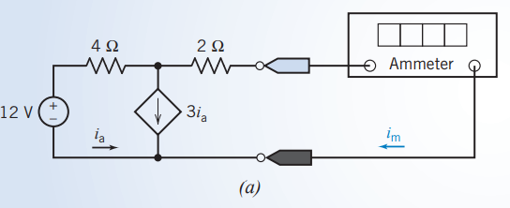
Problems
Problem 2. Determine the value of the current, in amps, measured by the ammeter in Figure a.

Slide 20
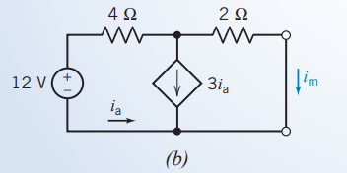
Problems
Problem 2. Determine the value of the current, in amps, measured by the ammeter in Figure a.
Solution:
An ideal ammeter is equivalent to a short circuit. The current measured by the ammeter is the current in the short circuit.
Figure b shows the circuit after replacing the ammeter with the equivalent short circuit.

Slide 21
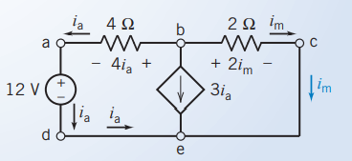
Problems…
Solution …
The circuit has been redrawn in the Figure to label the nodes of the circuit. This circuit consists of a voltage source, a dependent current source, two resistors, and two short circuits. One of the short circuits is the controlling element of the CCCS, and the other short circuit is a model of the ammeter.

Slide 22
Problems…
Solution …
Next, Ohm’s law tells us that the voltage across the 4Ω resistor is equal to 4i_{a} and that the voltage across the 2Ω resistor is equal to 2i_{m}.
Applying KCL at node b gives
- i_{a} - 3i_{a} - i_{m} = 0, - 4i_{a} = i_{m} , i_{a} = i_{m} /4
Applying KVL to closed path a-d-e-c-b-a gives
0 = - 4i_{a} + 2i_{m} -12 = -4(- i_{m} /4) + 2i_{m} - 12 = 3i_{m} - 12
Finally, solving this equation gives i_{m} = 4 A

Slide 23
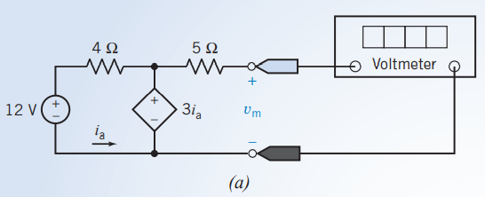
Problems…
Problem 3. Determine the value of the voltage, in volts, measured by the voltmeter in Figure a.

Slide 24
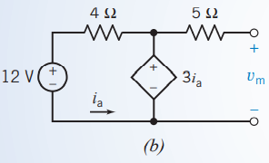
Problems…
Problem 3. Determine the value of the voltage, in volts, measured by the voltmeter in Figure a.
Solution:
An ideal voltmeter is equivalent to an open circuit.
The voltage measured by the voltmeter is the voltage across the open circuit.
The figure shows the circuit after replacing the voltmeter with the equivalent open circuit
This circuit consists of a voltage source, a dependent voltage source, two resistors, a short circuit, and an open circuit.
The short circuit is the controlling element of the CCVS, and the open circuit is a model of the voltmeter.

Slide 25
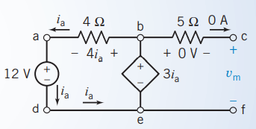
Problems…
Solution …
The circuit has been redrawn in the Figure to label the nodes of the circuit.
Applying KCL at node c, shows that the current in the 5Ω resistor is equal to the current in the open circuit, that is, zero.
Ohm’s law tells us that the voltage across the 5Ω resistor is also equal to zero.
Next, applying KVL to the closed path b-c-f-e-b gives v_{m} = 3i_{a}.
Applying KVL to the closed path a-b-e-d-a gives -4i_{a} + 3i_{a} -12 = 0
so i_{a} = -12 A
Finally, v_{m} = 3i_{a} = 3(-12) = -36 V

Slide 26
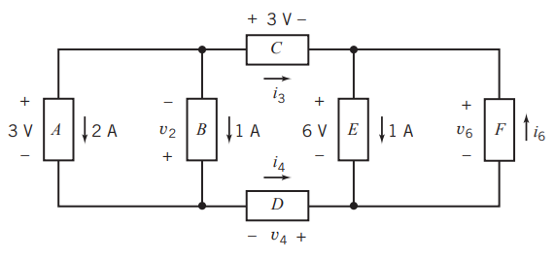
Practice Problem
Problem 1. Determine the values of i₃, i₄, i₆, v₂, v₄, and v₆ in Figure shown.

Slide 27
Answer: i₃ = -3 A, i₄ = 3 A, i₆ = 4 A, v₂ = -3 V, v₄ = -6 V, v₆ = 6 V

Slide 28
REFERENCES
[1] R.C. Dorf and James A. Svoboda, “Introduction to Electric Circuits”, 9th ed, John Wiley & Sons, 2013.

